Slide 1
DECLARATION
public
(Access Specifiers)
static
Access
modifiers
void
Return type
main
Method Name
(String []args)
(argument list)
{
Statement 1;
Statement 2;
…
…
}
DEFINATION
Access Specifies : Specifies the visibility of code component
Defines component is belonging to particular class or object
If return type is other than void then program should have return statement at he end of he program

Slide 2
METHODS
Methods are named block of codes which performs specific tasks
Method being called is known as called method
Method calling a method is known as calling method.
One class can contain multiple methods.
But method cannot contain another method inside it.
Any pre-defined words in java starting with small letter is a method which should have () after the name of the method. If there is no () then it is a variable.

Slide 3
ARRAYS
Group of homogeneous data that has some index and fixed size
DECLARATION:
datatype []arrayName;
datatype[] arrayName;
datatype arrayName[];
CREATION:
arrayName =new datatype[SIZE];
INITIALIZATION:
arrayName[index]=value;
DIFFERENT WAYS OF ARRAY DECLARATION AND INITIALIZATION
datatype[] arrayName = new datatype[SIZE] //all in single line
Datatype[] arrayName = {value1,value2,…};

Slide 4
STRINGS
String is a reference type.As a result string variable holds the address to an object created by string class.
Even though strings are primitive types java compiler has some features designated to let you work as non- primitive data types.
Java automatically converts the primitive type to a string.
String is a sequence of characters.
Strings are immutable.Once created cannot change the value or one cannot reinitialization.
User-defined data type.
Operator overloading is supported
String s = “hello”;
String str = “hello”;
DECLARATION AND INITIALIZATION
String stringName;
Str = “ value “ ;
String stringName=new String(“ value “ );

Slide 5
The string contains two parts.
Constant Pool →Duplication not allowed
Non-constant pool →Duplication are allowed
String Class
It is powerful but it is not efficient.
Because string objects are immutable, any method of the string class that modifies the string in any way must create a new string object. To overcome this problem java offers two alteration to the string class, StringBuffer and StringBuilder.
StringBuilder and StringBuffer are two major images.Both have the same methods and perform the same string manipulation.
StringBuffer is thread safe where as StringBuilder is not thread safe.
We cannot assign string literals(values) directly using StringBuilder and StringBuffer we have to create an object using new keyword.

Slide 6
CONSRUCTORS
public StringBuffer() {
super(16);
}
Constructs a string buffer with no characters in it and an initial capacity of 16 characters.
public StringBuffer(int capacity) {
super(capacity);
}
Constructs a string buffer with no characters in it and the specified initial capacity.
@param capacity the initial capacity.
@exception NegativeArraySizeException if the {@code capacity}
argument is less than {@code 0}.
StringBuffer sb2 = new StringBuffer(-1);
public StringBuilder() {
super(16);
}
public StringBuilder(int capacity) {
super(capacity);
}

Slide 7
public StringBuffer(String str) {
super(str.length() + 16);
append(str);
}
Constructs a string buffer initialized to the contents of the specified string. The initial capacity of the string buffer is
{@code 16} plus the length of the string argument.
@param str the initial contents of the buffer.
public StringBuilder(String str) {
super(str.length() + 16);
append(str);
}
StringBuffer sb = new StringBuffer("hello");
System.out.println(sb.length());//5
System.out.println(sb.capacity());//21

Slide 8
public StringBuffer(CharSequence seq) {
this(seq.length() + 16);
append(seq);
}
public StringBuilder(CharSequence seq) {
this(seq.length() + 16);
append(seq);
}
* Constructs a string buffer that contains the same characters
* as the specified {@code CharSequence}. The initial capacity of
* the string buffer is {@code 16} plus the length of the
* {@code CharSequence} argument.
* <p>
* If the length of the specified {@code CharSequence} is
* less than or equal to zero, then an empty buffer of capacity
* {@code 16} is returned.
* @param seq the sequence to copy.
* @since 1.5

Slide 9
String | StringBuffer | StringBuilder
We can assign the values directly to a string variable | Cannot create a string without new keyword
There are 16 constructors | There are only 4
Not efficient | More Efficient
Because of immutability cannot be used in threads | Threads safe | Not thread safe
When two different strings given same values they refer to same address | Does not refer to same address
 | Synchronization is affected due to thread safety | Better than StringBuffer

Slide 10
STRING METHODS
String str = “ jung kook”;
length() | To print length of a string. Return type is int. str.length(); //9
toCharArray() | To convert string to char array. Return type is char array char[] ch = str.toCharArray(); System.out.println(ch[8]);//k
charAt(index) | To get the character from the specified string. Return type is char. str.charAt(7) // 4 str.charAt(11); //string index out of range
equals(stringName) | To compare two strings. Concerned with cases. Return type is boolean. str.equals(str2) //false (str2= “JUNG_kook”)

Slide 11
String str = “ jung kook”; String str2 ="JUNG_kook"
replace(oldChar,newChar) | Replaces old characer with new. Return type is String. str.replace('o','i')//Jung_Kiik
equalsIgnoreCase(stringName) | Compares two strings. Not concerned with cases. Return type is boolean. str.equalsIgnoreCase(str2)//true
indexOf(singleChar) | To get index of specified character. First occcurence char index will be get . Return type is integer. str.indexOf('o')//6
toUpperCase() | To convert all the characters of string to upper case. Return type is string. str.toUpperCase()//JUNG_KOOK

Slide 12
toLowerCase(); | To convert all the characters of string to lower case. Return type is string str.toLowerCase()//jung_kook
substring(index) substring(beginning , ending)) | Prints letters after the index. Return type is string. str.substring(3) //g_Kook Print letters from beginning letter to ending-1 letters. Return type is string . str.substring(3,7) //g_Ko
contains(string) | To check whether the following string is present or not. Return type is boolean . str.contains("Jun")//true

Slide 13
REFERENCE TYPE
Reference type is a type that is based on class rather than primitive data type
It can be based on pre-defined classes in java or classes defined by programmer or developer.
Purpose of using new is to create objects. Since new is used in creating string it will create new object of string.
Reference type does not store content of the object but the address of the object where it is stored.

Slide 14
STATIC
Any member of the class that has been declared as static is a static member.
No need to create a object of class which has been declared as static. Static member of a class can be used in another class without creating object.
static variable declaration inside static method is not allowed
NON-STATIC
Member of class which has been not declared with static keyword.
When used in another class then object creation is mandatory

Slide 15
VARIABLES
LOCAL
GLOBAL
PRIMITIVE
REFERENCE
PRIMITIVE
REFERENCE
STATIC
NON-STATIC
STATIC
NON-STATIC

Slide 16
public class static_non_static {
public static void main(String[] args) {
static_non_static sm = new static_non_static();
int a=calcArea(4); //static method
System.out.println(a+" is the area of square");
int areaR = sm.areaRec(4,2); //non-static method
System.out.println(areaR+" is the area of rectangle");
}
public static int calcArea(int side){
int area=side*side;
return area;
}
public int areaRec(int l,int b){
int area=l*b;
return area;
}
}

Slide 17
public class static_non_static {
int a=0; //non-static variable
static int area =0; //static variable
public static void main(String[] args) {
static_non_static sm = new static_non_static();
sm.a=calcArea(4); //using non-static variable
System.out.println(sm.a+" is the area of square");
int areaR = sm.areaRec(4,2);
System.out.println(areaR+" is the area of rectangle");
}
public static int calcArea(int side){
area=side*side; //using static variable
return area;
}
public int areaRec(int l,int b){
area=l*b;
return area;
}
}

Slide 18
public static int calcArea(int side){
area=side*side;
int n = sm.areaRec(2,3); //local variable
System.out.println(n+" is the area of rectangle");
return area;
}

Slide 19
CONSTRUCTORS
It is a special type of method which has a same name as class name and does not have any return type.
Invoked when object is created.
D:\UST_Global\java>javac demo.java
D:\UST_Global\java>javap demo
Compiled from "demo.java"
public class demo {
public demo();
}
public class demo{
}

Slide 20
public class demo{
public demo(int i){
}
public static void main(String args[]){
}
}
D:\UST_Global\java>javac demo.java
D:\UST_Global\java>javap demo
Compiled from "demo.java"
public class demo {
public demo(int);
public static void main(java.lang.String[]);
}
public class demo{
public static void main(String args[]){
}
}
D:\UST_Global\java>javac demo.java
D:\UST_Global\java>javap demo
Compiled from "demo.java"
public class demo {
public demo();
public static void main(java.lang.String[]);
}

Slide 21
No-argument constructor will be created by programmer.
Can have statements inside body.
public ConstructorExample() {
System.out.print("helloo Vibha");
}
public static void main(String[] args) {
ConstructorExample ce= new ConstructorExample();
}
Default constructor will be created by compiler.
Cannot have any statements inside body.
Parameter Constructor : Constructor having arguments passed
public ConstructorExample(String i) {
System.out.println("helloo Piaa");
}
ConstructorExample ce1= new ConstructorExample("a");

Slide 22
CONSTRUCTOR OVERLOADING
DIFFERENT TYPE AS PARAMETERS:
public ConstructorExample( int i ) {
System.out.println("helloo Vidya");
}
public ConstructorExample( String i ) {
System.out.println("helloo Piaa");
}
public static void main(String[] args) {
ConstructorExample ce= new ConstructorExample( 1 );
ConstructorExample ce1= new ConstructorExample( "a“ );
}

Slide 23
Different order of arguments
public ConstructorExample(String i,int j) {
System.out.println("consructor with first string and second is int");
}
public ConstructorExample(int i,String j) {
System.out.println("consructor with first int and second is String");
}
public static void main(String[] args) {
ConstructorExample ce2= new ConstructorExample("a",1);
ConstructorExample ce3= new ConstructorExample(1,"a");
}

Slide 24
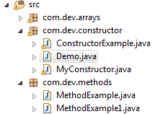
PACKAGES
To import any classes from one package to another package we use the import statement.
Package helps in managing data in proper manner and helps in code re-useability
package com.dev.constructor;
import com.dev.methods.MethodExample;
public class Demo {
public static void main(String[] args) {
int i = MethodExample.calcArea(3);
System.out.println(i);
}
}

Slide 25
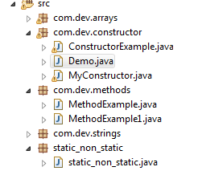
static_non_static.java
public static int area=0;
public static int calcArea(int side){
area=side*side;
int n= sm.areaRec(2,3);
return area;
}
public int areaRec(int l,int b){
area=l*b;
return area;
}
Demo.java
import static_non_static.static_non_static; //importing package
int j = static_non_static.calcArea(3); //class from static_non_static
System.out.println(static_non_static.area); //static variable from static_non_static

Slide 26
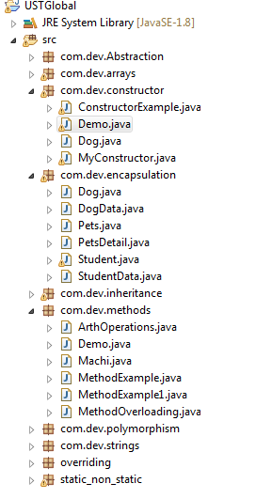
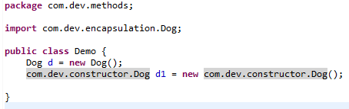
When one wants to access two classes from two different packages having same class name, one class package can be imported and another by fully qualified
import com.dev.methods.MethodExample; → Importing package
com.dev.methods.MethodExample → Fully qualified class

Slide 27
DATA-TYPES
Entity declared as public can be used by any other classes. Can be accessed by any of the classes or packages
Method declared as protected cannot be accessed by any other packages. Can be accessed by different classes in same package.
Can be used under certain conditions.(inheritance)
Package level/ default can be accessed by any of the classes in same package. Cannot be used in other packages.
Private entities can be accessed only within that class.

Slide 28
V
I
S
I
B
I
L
I
T
Y
S
E
C
U
R
I
T
Y
public
protected
default
private

Slide 29
ASSOSIATION
Association in java is relationship between two different classes.
One to one
One to many
Many to many
Many to one
Aggregation :A class not dependent on another class.
Has A Relationship
Composition: A class dependent on another class
Is A Relationship
Inheritance

Slide 30
INHERITANCE
The process by which one class acquires the properties and functionalities of another class is called as inheritance.
The aim of inheritance is to provide code re-useability.
Class whose properties or functionalities are being inherited by other class is called “parent class , super class or base class”.
Class that inherits properties from other class is called ”child class, sub class o derived class”.
To make use of inheritance in java make use of keyword extends
One can access properties of super and sub class using object of sub class.
Final classes cannot be inherited , final members of a super class can be inherited but cannot be changed.
Private members and constructors of super class cannot be inherited.

Slide 31
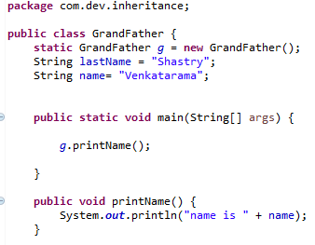
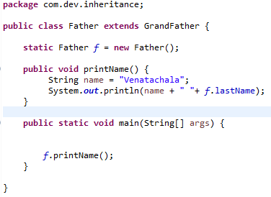
TYPES OF INHERITANCE
Single Inheritance : A class aquiring the properties from another class.

Slide 32
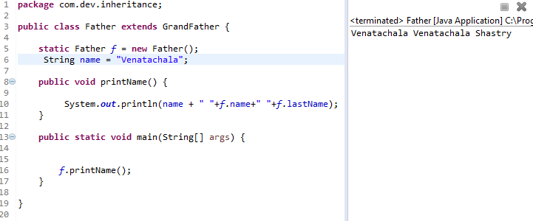
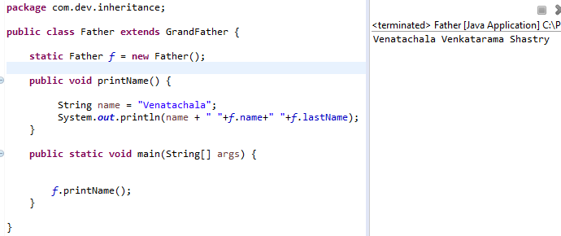

Slide 33
Multiple level is not supported in java. Compiler gets confused to acquire properties from different parents.
Diamond problem.
Hierarchical level
Multi level

Slide 34
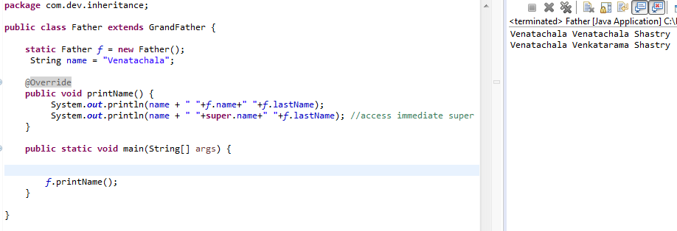
SUPER
Super keyword refers to an object of immediate parent o super class.
To access the data member of a parent class when both child and parent class when they have data member with same name.

Slide 35
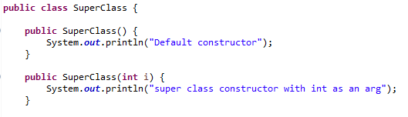
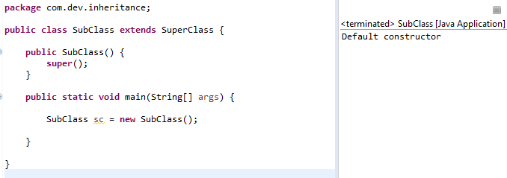
SUPER()
Calling super class constructor in sub class.

Slide 36
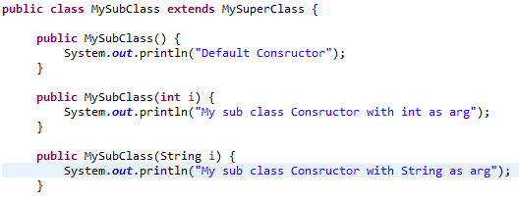
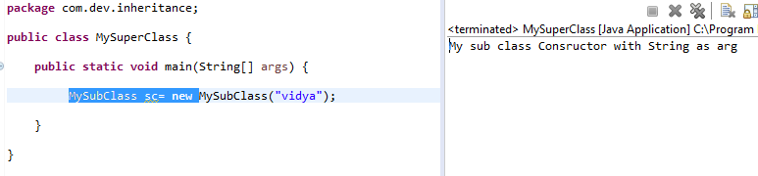
Calling sub class constructor in super class.

Slide 37
METHOD OVERRIDING
Declaring a method in child class which has already been declared in parent class is known as method overriding.
Method overriding is done to providing implementation specific to a child class.
Overidden method will be written in parent and overriding will be written in child.
Advantage is that one can provide implementation to the child class method without changing the code present in parent class.
Private methods cannot be overridden.
Final methods can be inherited but cannot be changed

Slide 38
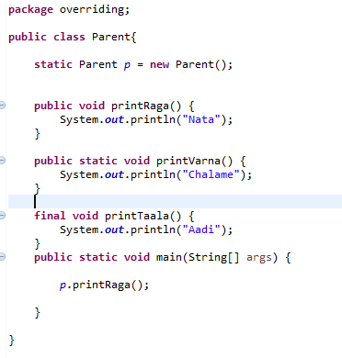

Slide 39
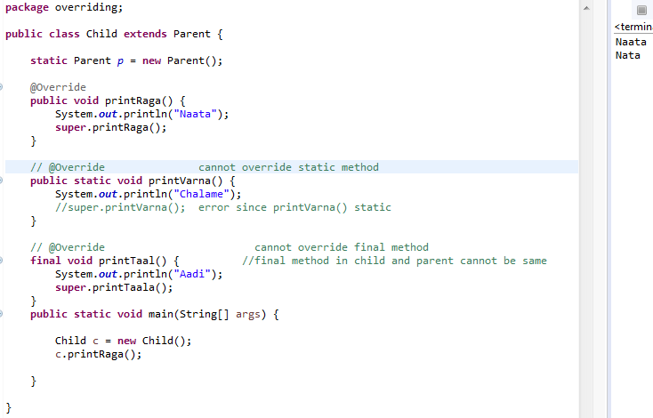

Slide 40
METHOD OVERLOADING
It is a feature in JAVA that allows us to have same methods(same name) in a single class more than once provided the argument lists differ:
Number of parameters
Order of parameters
Data-type of parameters
Return type of methods having same name does affect even when return types are different but not the argument.
Static method does not affect method overloading.

Slide 41
POLYMORPHISM
One method acting differently for different classes.
Method overriding is a type of polymorphism.
Method overriding is an example of run-time polymorphism since called at the time of execution
At the time of execution method declaration is connected with that particular method definition. Since this happens during run time overriding is called “Run-time polymorphism”/”late binding”.
In method overloading, at the time of compilation they act according to number of arguments passed and based on this specific method declaration will be bind. Since this happens during compilation its called “Compile –time polymorphism”/”Early binding”.

Slide 42
ABSTRACTION
Only concerned with invoking method or functionalities but not with implementation.
Ex: println()
Any invoking method can be called as abstraction.
Hiding implementation and providing only functionalities .
Advantage : Application built by one can only send .class file to client rather than giving code since he can change the code as a result there might be crash in application due to change in code.

Slide 43
ABSTRACT CLASS
Any method declared with keyword abstract is known as abstract class.
It does not have a body.
It can have both abstract methods as well as concrete methods.
Any class having an abstract method should be declared as abstract.
If a class is declared as abstract it is not mandatory to have abstract method.
Objects cannot be created for abstract classes.
They can have constructors.
One should override each and every method in child from abstract parent class. To avoid this make child class an abstract.
If concrete class is extending abstract class then it should override all the abstract methods declared in that abstract class.

Slide 44
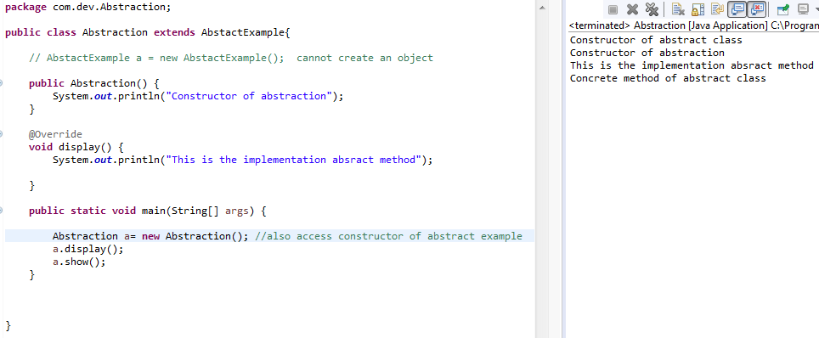
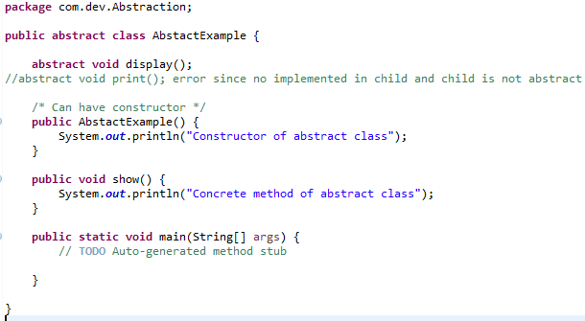

Slide 45
INTERFACE
When a single class wants to inherit the properties from two different classes its not possible in java so overcome this problem a concept called interface was introduced. Achieved using keyword implements.
Interface is just like a class where we declare methods.
By default , methods declared in interface will be abstract methods & public.
Interfaces cannot have constructors.
Concrete methods can be created in interface as default or static. If declared default then call by object if not then by interface name.
Variables can be created in interface as default, static and final. They cannot be declared but if declared they should be initialized.
One interface cannot implement another interface but a class can extend any number of interfaces at a time. But one class cannot extend two classes at a time.

Slide 46
TYPES OF INTERFACE
If an interface is Functional Interface then that interface can have only one abstract method but can have any number of concrete methods. Functional interface is recognized by using @FuncionalInterface.
If an interface does not contain any methods then it is called Marker Interface.Used to provide special behaviour to class , which can be achieved using Marker interfaces. Serializable, Remote, cloneable are some of the marker interfaces. Clone is a method in object to provide special behaviour to the class.
If an interface has n number of methods then it is called Typical Interface .

Slide 47
Abstract | Interface
Keyword - abstract | Keyword – interface
Methods declared with abstract keyword | Methods declared will be by default abstract and public
Constructors can be created | Cannot be created
Abstract classes are extended | Interfaces are implemented
To achieve Multi level inheritance | To extract properties from two different classes i.e multiple inheritance
Concrete methods can be in any visibility | Concrete methods should be either static or default
A class can extend only one class. | A class can implement more than one interface

Slide 48
All the classes and methods present in java.lang will be imported automatically. They need not to be imported explicitly.
Ex. Cloneable is an interface present in java.lang it need not be imported explicitly
But Serializable is an interface present in java.io. Which need to be imported explicitly

Slide 49
ENCAPSULATION
Enacapsulation is a mechanism with which we wrap up the data members and function methods
It helps to hide the data.
Using this one can make data read only (only getters) or write only(only setters).
Also called data hiding.

Slide 50
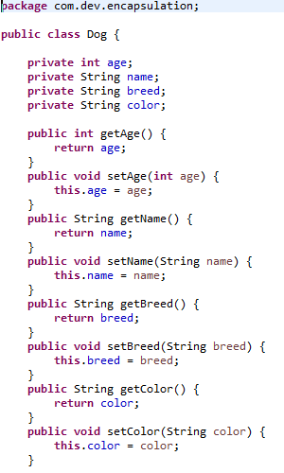
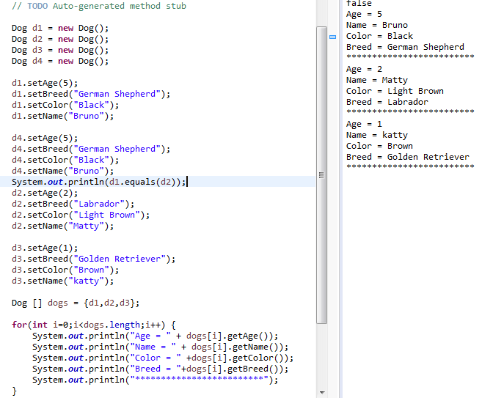

Slide 51
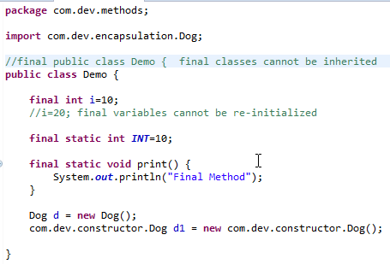
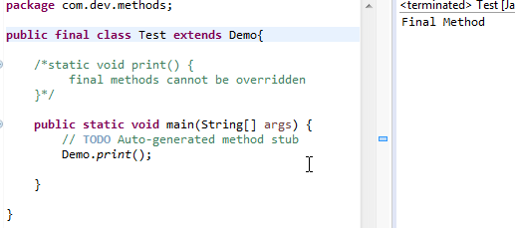
FINAL
Variable initialized as final cannot change its value inside its scope.
Final methods cannot be overridden.
Super class cannot be final class but sub class can be final

Slide 52
OBJECT
In java each and every class directly or indirectly inherits the properties of object class i,e object class is the super most class in java.
Each and every class either a pre-defined class or a user defined class is a child class of object.
Object is super most class among all the classes present in java programming java.

Slide 53
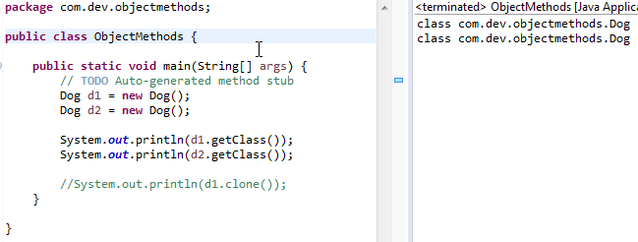
getClass() :
Returns name of the class it belongs to.

Slide 54
equals():
Should be used along with hashCode() otherwise boolean value will be false even though they are equal. Need to override to use equals to compare two objects.To do this go to source and select generate equals() and hashCode()

Slide 55
Methods of object class:
Dog d1 = new Dog();
Object Class | Description
clone() | To use this the class should extend cloneable method.
equals() | Should be used along with hashCode() otherwise boolean value will be false even though they are equal. Need to override to use equals to compare two objects.To do this go o source and select generate equals() and hashCode() d1.equals(d4) // true
toString() | Override
Wait()

Slide 56
EXCEPTIONS
Exception is an error event which happens during the execution of a program. It disrupts the normal flow of program.
Database server down, hardware failure, network connection failure
Exception Handling
Overcoming problems during run-time or exceptions.
Java being OOP language wherever an error occurs while executing a statement, creates an exception object and then the normal flow of program halts and JRE tries to find someone who can handle the raised exception
Exception object contains a lot of debugging information such as method hierarchy, line number where the exception occurred, type of exception etc

Slide 57
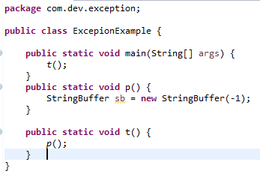
Exception in thread "main" java.lang.NegativeArraySizeException
at java.lang.AbstractStringBuilder.<init>(AbstractStringBuilder.java:68)
at java.lang.StringBuffer.<init>(StringBuffer.java:128)
at com.dev.exception.ExcepionExample.p(ExcepionExample.java:21)
at com.dev.exception.ExcepionExample.t(ExcepionExample.java:25)
at com.dev.exception.ExcepionExample.main(ExcepionExample.java:14)
Method Hierarchy

Slide 58
When the exception occurs in a method, the process of creating an exception object and handling it to run-time environment is called throwing an exception.
Once runtime receives the exception object, it tries to find the handler for the exception. Exception handler is a block of code that can process the exception object.
Logic :Starting the search in the method where error occurred. If not found then it is passed to calling method and so on.
If any exception is found, exception object is passed to handler to process it. The handler is said o be exception handler.
Exception cannot solve compile time errors.
Differentiate exceptions and errors:
Errors are solved using programming skills, errors occur during compile time
Exceptions are solved using exception handler, occurs during run-time

Slide 59
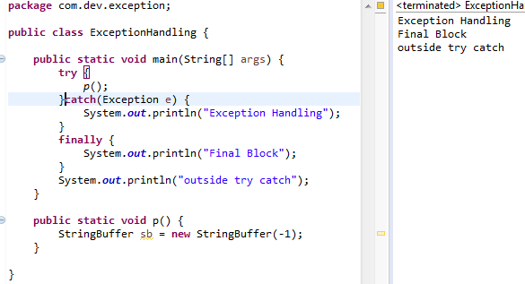
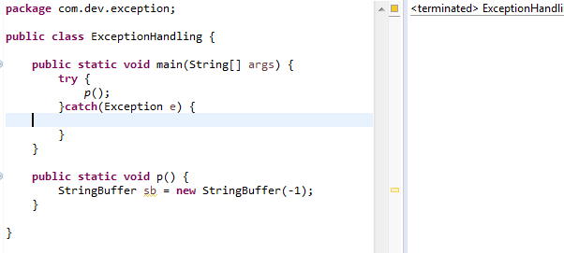
try-catch – used for exception handling our code. Try can have multiple catch bloc and we can have nested try-catch. Catch block should take parameter that should be of type exception. If exception parameter need to be included in catch,then should be written in last catch block .[Try can have arguments.(resources from JDBC)]

Slide 60
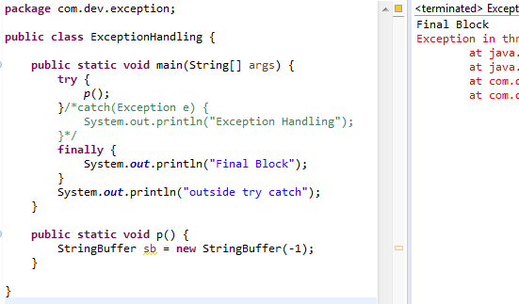
finally – code written here will be executed even if there is try-catch or any exceptions.Finally can have try catch

Slide 61
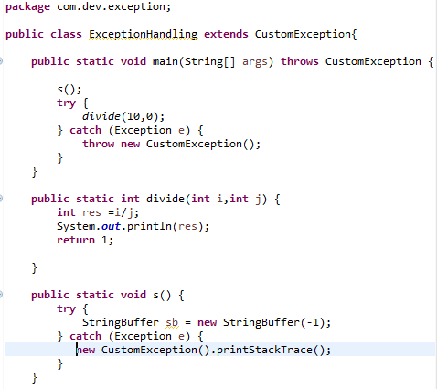
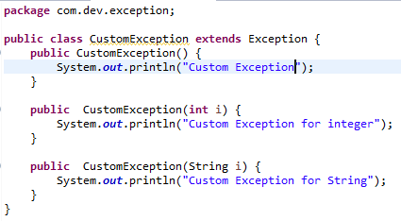
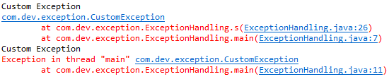
throw – exception defined or thrown by developer

Slide 62
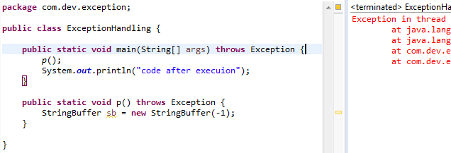
throws –where exception is pre-defined. It is used when calling method is throwing an exception. It tells that a method might thrown an exception
When a method is declared as throws then the method which calls this method should also be declared as throws.
Can provide more than one exception at once.

Slide 63
Java exceptions are hierarchical and inheritance is used to categorize different types of exception.
throwable is a parent class of java exceptions hierarchy and it has two child objects – Error and Exceptions.
Errors : Errors are exceptional scenarios that are out of scope of application and its not possible to anticipate and recover from them.
Ex: Hardware failure,JVM crash or out of memory error.
Exception scenarios which can be anticipated are checked Exception.
Provide errors at compilation time /warnings and errors during run-time.
Should be caught and provide useful information to user(will be written in catch).
Exceptions caught during compile-time are check exceptions.
Try and catch for catch exceptions/try and finally in unchecked.

Slide 64
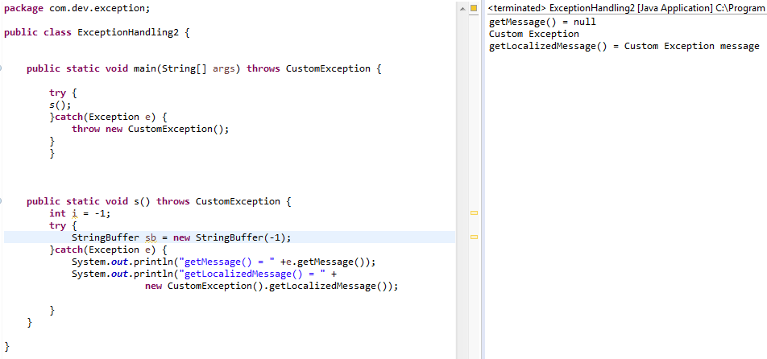
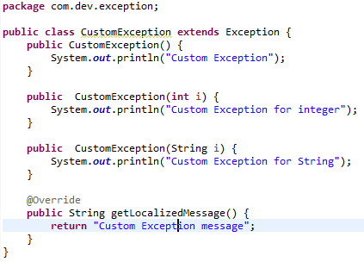
getMessage():
Method of throwable.
Return type is string.
If not overridden then output will be null. But should not be overridden to get custom message.But should not be used to print custom messages.???
getLocalizedMessage():
Method of thowable. Retuns getMessage();
Return type is string. Should be overridden to get custom exception

Slide 65
COLLECTIONS
Containers that group multiple items in a single unit. They are used almost in every programming language and when java arrived, it also came up with collection classes. Introduced in java 1.2.
To iterate and manipulate in a standard way → Collections Framework
Interfaces →Provides abstract data type to represent collections.
Root interface of collection framework → java.util.collection.
Methods→ size(),iterator(),clear(),add(),remove()→these should be implemented.
Java interfaces → list , set , Queue ,Map (interface of collection framework but not from collection) (abstract data type )
All collection frameworks are present in java.util.
Unless there is implementation interfaces are not useful.
Create different types of collections in java program using collection classes.
Collection Classes → arrayList,linkedList,treeMap,hashMap.treeMap

Slide 66
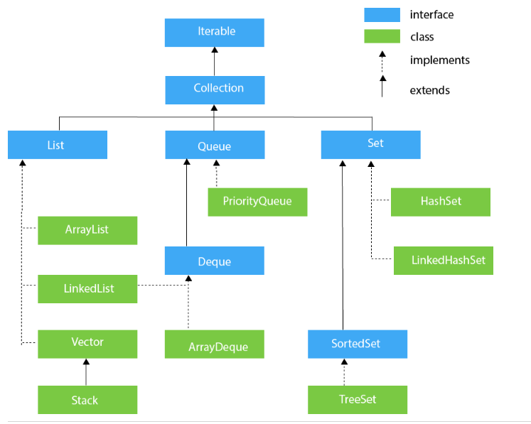

Slide 67
Benefits :
Reduced Development Effort
Increased quality
Reusability and interoperability.
Java are the foundation of the java collections framework. All the core collection interfaces are generic(generic → added for compile time checking if we want a collection to store a string object we can write as <string>.).
Syntax: public interface Collections<E>
It specifies type of object declared. It helps in reducing run-time errors by type-checking the objects during compile time.
To overcome ClassCastException generic was introduced.
If an unsupported operation is invoked, a collection implementation throws UnsupportedOperationException

Slide 68
COLLECTION INTEFACE
Has methods to tell how many elements are in collections.
Size→return type→int
isEmpty→return type →boolean→Return true if collection contains specific element.
add(E e) →boolean →true when perticular element is added →E is generic type
Remove(Object o) → boolean
Iterator() → iterator type object. Introduced in java1.2.
Bulk operation methods which can be applied to whole collection.
containsAll(Collection<?> e) → boolean
addAll,removeAll,seAll.clearAll;
SET INTERFACE
Set is a collection that cannot contain duplicate elements.Used to represent sets,deck of cards
Set implimenation → HashSet,treeSet and LinkedHashSet
At most one null element

Slide 69
LIST INTERFACE
An ordered collection
Unlike sets, lists typically allow duplicate elements. More formally, lists typically allow pairs of elements <tt>e1</tt> and <tt>e2</tt> such that <tt>e1.equals(e2)</tt>, and they typically allow multiple null elements if they allow null elements at all.
Index helps to access any elements
QUEUE
A collection designed for holding elements prior to processing. Besides basic {@link java.util.Collection Collection} operations, queues provide additional insertion, extraction, and inspection operations.

Slide 70
Queue Methods
boolean add(E e); → Inserts the specified element into this queue if it is possible to do so immediately without violating capacity restrictions.
Throws exception like ClassCastException,NullPoinerException.
IllegalStateException
boolean offer(E e); →Inserts the specified element into this queue if it is possible to do so immediately without violating capacity restrictions. When using a capacity-restricted queue, this method is generally preferable to {@link #add}, which can fail to insert an element only by throwing an exception.
@return {@code true} if the element was added to this queue, else {@code false}
E remove(); → Retrieves and removes the head of this queue. This method differs from {@link #poll poll} only in that it throws an exception if this queue is empty.
E poll(); → Retrieves and removes the head of this queue , or returns {@code null} if this queue is empty.

Slide 71
E element();
Retrieves, but does not remove, the head of this queue. This method differs from {@link #peek peek} only in that it throws an exception if this queue is empty.
E peek();
Retrieves, but does not remove, the head of this queue, or returns {@code null} if this queue is empty.
MAP INTERFACE
An object that maps keys to values. A map cannot contain duplicate keys; each key can map to at most one value.
Map implimentations are HashMap, TreeMap and LinkedHashMap.
Map methods like put(),remove(),get(),containsKey(),containsValue(),size()

Slide 72
HashSet
HashSet Class→ Basic implementation of the set interface that is backed up by HashMap.It makes no guarantees as to the iteration order of the set; in particular, it does not guarantee that the order will remain constant over time. This class permits the <tt>null</tt>element.
Basic operations → add(),remove(),contains(),size()
One can set initial capacity and load factor for this collection.
Load factor → Specifies at which level/point set should increase its capacity.
public HashSet() {
map = new HashMap<>();
} →Constructs a new, empty set; the backing <tt>HashMap</tt> instance has default initial capacity (16) and load factor (0.75).
public HashSet(Collection<? extends E> c) {
map = new HashMap<>(Math.max((int) (c.size()/.75f) + 1, 16));
addAll(c);
}

Slide 73
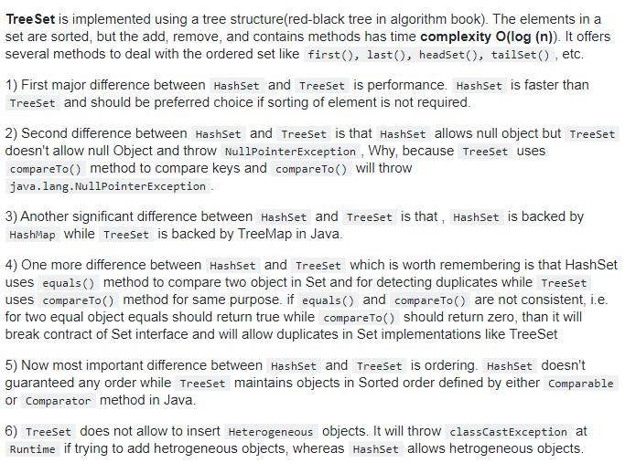
TreeSet
HashSet doesn't guaranteed any order while TreeSet maintains objects in Sorted order defined by either Comparable or Comparator method in Java.

Slide 74
public TreeSet() {
this(new TreeMap<E,Object>());
}It is used to construct an empty tree set that will be sorted in ascending order according to the natural order of the tree set.
public TreeSet(Comparator<? super E> comparator) {
this(new TreeMap<>(comparator));
}
It is used to construct an empty tree set that will be sorted according to given comparator
public TreeSet(Collection<? extends E> c) {
this();
addAll(c);
}
It is used to build a new tree set that contains the elements of the collection c.
public TreeSet(SortedSet<E> s) {
this(s.comparator());
addAll(s);
}
It is used to build a TreeSet that contains the elements of the given SortedSet.

Slide 75
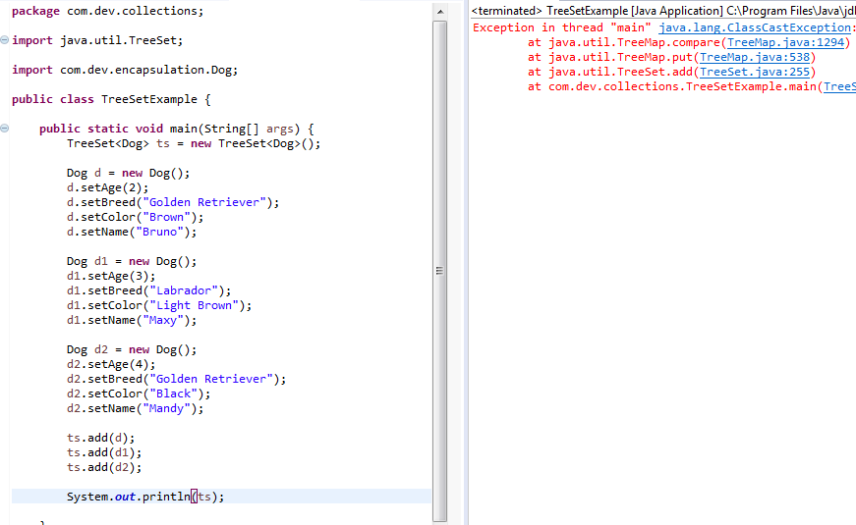
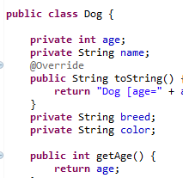
Before implementing Comparable<> in Dog

Slide 76
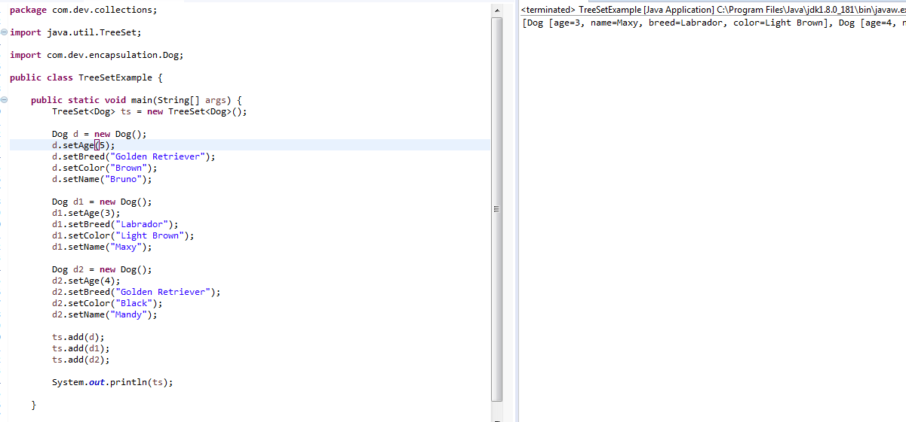
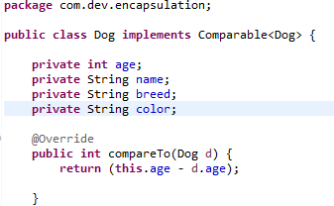
After implementing Comparable<> in Dog
Output executed in order to id. Since id is compared in overridden compareTo()

Slide 77
ArrayList
public void trimToSize() {
}
Trims the capacity of this <tt>ArrayList</tt> instance to be the list's current size. An application can use this operation to minimize the storage of an <tt>ArrayList</tt> instance.
public void ensureCapacity(int minCapacity) {
}
Increases the capacity of this <tt>ArrayList</tt> instance, if necessary, to ensure that it can hold at least the number of elements specified by the minimum capacity argument. @param minCapacity the desired minimum capacity

Slide 78
public ArrayList(int initialCapacity) {
}
public ArrayList() {
this.elementData = DEFAULTCAPACITY_EMPTY_ELEMENTDATA;
}
Constructs an empty list with an initial capacity of ten.
public ArrayList(Collection<? extends E> c) {
}
Constructs a list containing the elements of the specified collection, in the order they are returned by the collection's iterator.@param c the collection whose elements are to be placed into this list @throws NullPointerException if the specified collection is null.

Slide 79
Collection | Overriding | Key value | Duplicate Elements | Null element | Thread Safe | Load factor | Ensure capacity
ArrayList | Yes | no | Yes | yes | No | yes | Yes
LinkedList | Yes | No | Yes | Yes | No
HashSet | No | No | No | Yes | No | Yes | Yes
TreeSet | Yes | No | No | No | No
HashMap | No | Yes | No | Yes | No | Yes | Yes
TreeMap | Yes | Yes | No | No | No
Hashtable | No | Yes | No | No | Yes | Yes | Yes
Vector | yes | No | yes | Yes | Yes | yes

Slide 80
JAVA LAMBDA EXPRESSIONS
New features of java 8.
It provides clear and concise way to represent functional interface using an expression.
It helps to iterate, filter and extract data from collection.
The lambda expression is used to provide the implementation of a functional interface.
In case of lambda expression we don’t need to define the method again for providing the implementation.
Providing less coding
Syntax:
Argument-list → {body}

Slide 81
THREADS
A thread is a single sequence of executable code with a larger program.
The main thread that starts automatically when you run a program .
Java lets to create programs that start additional threads to perform specific tasks.
Multiple programs are run parrellaly.
Multithreading is a java feature that allows concurrent execution of two or more parts of a program for max utilization.
MULTIHREADING

Slide 82
Threads Creation
Threads can be created in two ways:
By extending thread class
By implementing runnable interface
To start a thread start() method is invoked which internally invokes run().???
By extending thread class
Create a class that extends the java.lang.Thread.
This class overrides the run() method available in the Thread class
By implementing runnable interface
Create a new class which implements Runnable interface and override run() method.

Slide 83
Thread Properties:
Thread Name →Thread name can be created by programmer in order to identify tthreads
Thread id→. It is a unique number which is created and assigned by the thread scheduler to every single thread in order to identify them uniquely.
Thread Priority →It is used by the thread scheduler to decide the order of execution of the given threads.
It is an integer value ranging between 1-10 which can be set by using setPriority();
To make data in consistence then we have to use join, sleep or make method synchronized

Slide 84
Thread method creates the system resources, necessary to run the thread, schedules the thread to run, and calls the thread’s run method.
States:
New →Thread that has no started yet
Runnable → When start() method is called on thread it enters runnable state.
Running →Thread scheduler selects thread to go from runnable to running state. In running state Thread starts executing by entering run() method. >Thread scheduler selects thread from the runnable pool on basis of priority, if priority of two threads is same, threads are scheduled in unpredictable manner. Thread scheduler behaviour is completely unpredictable.
>When threads are in running state, yield() method can make thread to go in Runnable state.

Slide 85
Blocked → In this state a thread is not eligible to run.
>Thread is still alive, but currently it’s not eligible to run. In other words. > How can Thread return from waiting to runnable state ?
Once notify() or notifyAll() method is called object monitor/lock becomes available and thread can again return to runnable state.
Waiting → A thread waiting for another thread to perform.
> How can Thread go from running to waiting state ?
By calling wait() method thread go from running to waiting state. In waiting state it will wait for other threads to release object monitor/lock. wait(),notify(),notifyAll()
Deadlock →Threads blocked forever. Overcome ITC(Inter Thread Communication).wait(),notify(), notifyAll().
Terminated → A thread is considered dead when its run() method completes. destroy() method puts thread directly into dead state.

Slide 86
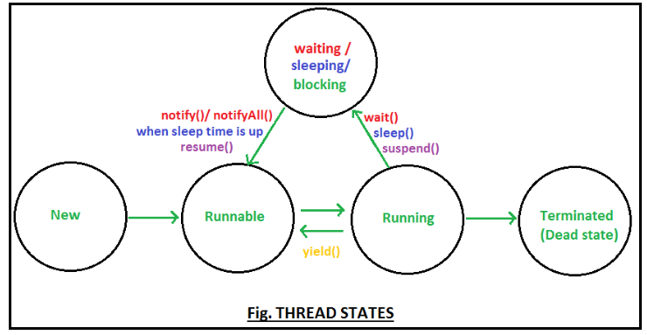

Slide 87
SYNCHRONIZATION
In many cases concurrently running threads share data and two threads try to do operations on the same variables at the same time. This often results in corrupt data as two threads try to operate on the same data.
A popular solution is to provide some kind of lock primitive
run() | start()
New thread is not created when invoked but executes | New thread will be created when invoked and executes run()
run() can be called multiple times | start() can be called only once. Throws illegalStartException
Defined in java.lang.runnable | Defined in java.lang.thread

Slide 88
sleep() | wait()
Pauses the thread for few seconds | Thread waits until nottify() or notifyAll () is called.
sleep() is used to pause the execution | wait() is used for inter-thread communication
sleep() doesn’t releases the lock or monitor while waiting. | wait() releases the lock or monitor while waiting.
for multi-thread-synchronization | for time-synchronization

